Slide 1
MySQL Data Analysis Project - Atliq Hardwares
Hariharan.N

Slide 2
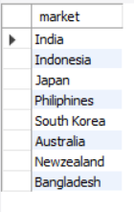
Question-1
Provide the list of markets in which customer "Atliq Exclusive" operates its business in the APAC region

Slide 3

Question-2
What is the percentage of unique product increase in 2021 vs. 2020?
Insight: Demand and production both increased

Slide 4
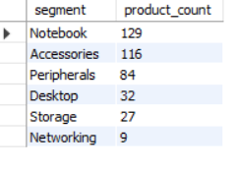
Question-3
Provide a report with all the unique product counts for each segment and sort them in descending order of product counts.
Insights: Segments: notebooks, accessories, and peripherals are showing significant manufacturing growth as compared to desktops, storage, and networking.

Slide 5
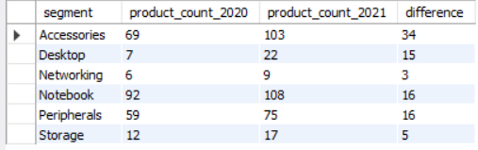
Question-4
Follow-up: Which segment had the most increase in unique products in 2021 vs 2020?
Insights: Accessories had the largest increase in production.
Storage and networking are experiencing slower production growth than other segments.

Slide 6

Question-5
Get the products that have the highest and lowest manufacturing costs.
Insights:
AQ Master wired x1 Ms has the lowest manufacturing cost.
AQ Home Allin1 Gen2 has the highest manufacturing cost

Slide 7
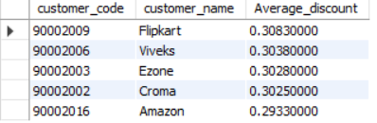
Question-6
Generate a report which contains the top 5 customers who received an average high pre_invoice_discount_pct for the fiscal year 2021 and in the Indian market
Insights: The largest average discount was given to Flipkart. The least average discount was given to Amazon.

Slide 8
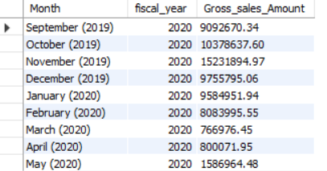
Question-7
Get the complete report of the Gross sales amount for the customer “Atliq Exclusive” for each month. This analysis helps to get an idea of low and high-performing months and take strategic decisions.
Insights: The lowest Gross sales total for both fiscal years is in March .
The highest Gross sales total for both fiscal years is in November

Slide 9
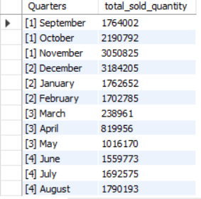
Question-8
In which quarter of 2020, got the maximum total_sold_quantity?
Insights:
Quarter 1 of FY2020 saw the most units sold overall, while Quarter 3 had the fewest

Slide 10
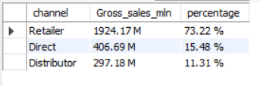
Question-9
Which channel helped to bring more gross sales in the fiscal year 2021 and the percentage of contribution?
Insights:
Channel "Retailer" helped bring maximum sales to the company with 73.22% as the contribution percentage.
Channel "Distributor" makes the least contribution at a percentage of 11.31%.

Slide 11
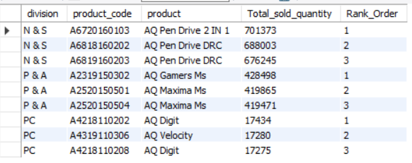
Question-10
Get the Top 3 products in each division that have a high total_sold_quantity in the fiscal_year 2021?
Insights: Every division has a product with different variants that appears twice in the top three products by division list.

Slide 12
THANK-YOU

